Slide 1

EMOTION DETECTION
PRAJEETH KUMAR M J
18BCE2354
VISHAL VEERAMANI
18BCE2360

Slide 2
Demo Video Link
https://www.youtube.com/watch?v=wpVYZwIhuaQ

Slide 3
Abstract
Human emotion and facial expression is one of the most powerful tool of human interaction. Detecting and recognizing human emotion is a big challenge in computer vision and artificial intelligence. Emotions are a big part of human communication since most of the communication takes place through emotion. Aim of our project is to develop a robust system which can detect human emotion. This can be used by people affected by autism to make them understand these emotions better.

Slide 4
Comparison of existing and proposed model
There already exists models where the application detects facial expressions, but the model does the bare minimum of just predicting the emotion and display the inference.
We want to develop an interface that portrays the accuracy of all the emotions present, as well create another part of the application where the users can upload an image which can detect the application and says the emotion.

Slide 5
Challenges/ issues of existing system
The existing model application is capable to detect some emotions which are universal to all human beings like angry, sad, happy, surprise, fear, disgust and neutral, that is present in our project, but the interface is not user friendly, the gui is not clear and the skill to operate the project is very high.
This would not bode well for our target audience since we are trying to attract people affected by autism and encourage them to understand these emotions. Another user base is casual users who just want to try how the application works.

Slide 6
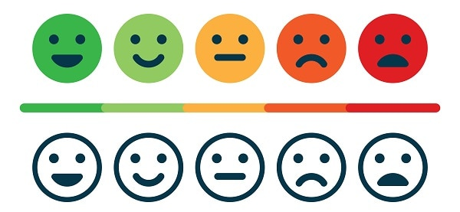
Objectives
To program an user friendly application to detect some emotions which are universal to all human beings like angry, sad, happy, surprise, fear, disgust and neutral, which can be used by users with minimal to no experience about current trends in technologies and with the gui and hci principles.

Slide 7
Architecture Diagram(Flow of the work)
This diagram refers to the flow of our website in a sequential manner.

Slide 8
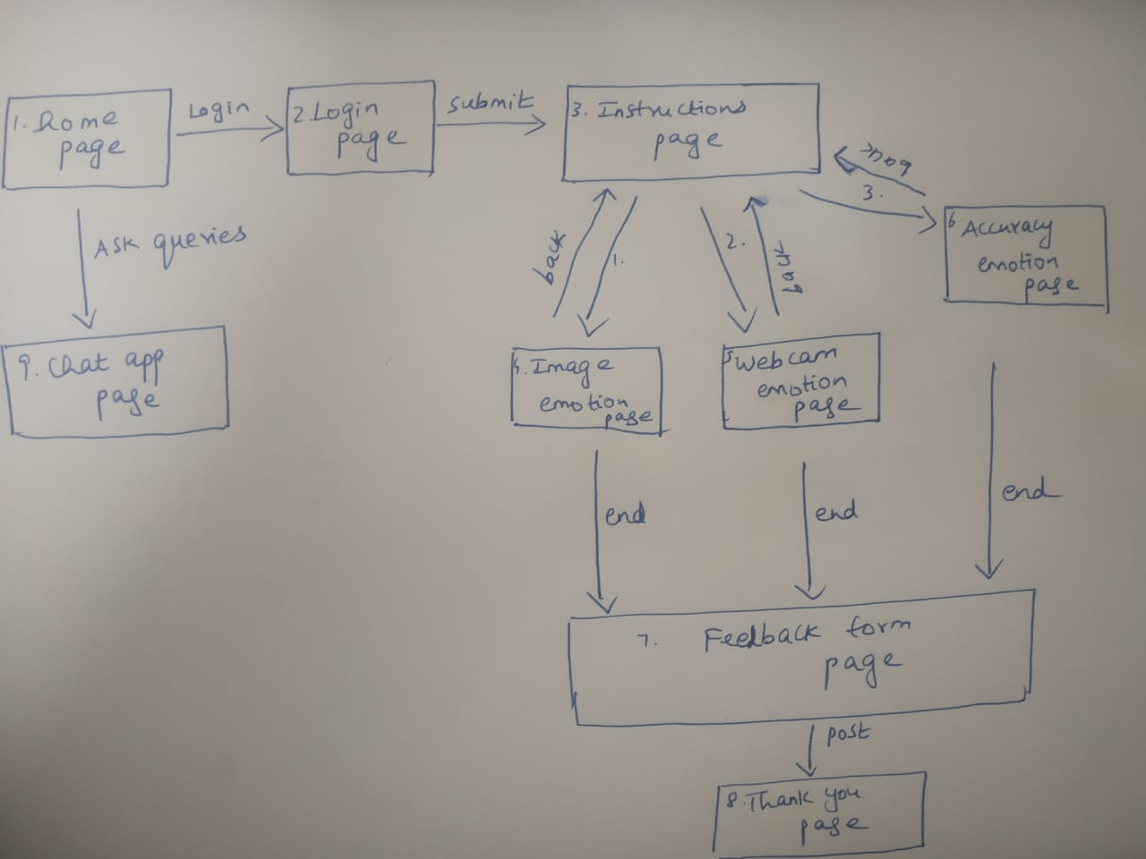

Slide 9
Real client and Stakeholders
A bright and colorful website using facial recognition and emotion detection AI to have fun making faces! Entertaining for all types, and especially useful for people with autism and/or asperger's to learn and practice emotional recognition.
It is helpful for the physically challenged people to detect their emotion.
The users or customers are one of the real clients of the website.

Slide 10

Modules wise description
Our model name is Sentimeter(which detects the sentiments).
Work breakdown structure:
1. Home page
2. Login page
3. Instruction page
4. Image emotion
5. Webcam emotion
6. Accuracy emotion
7. Feedback page
8. End page
9. Chat application page

Slide 11
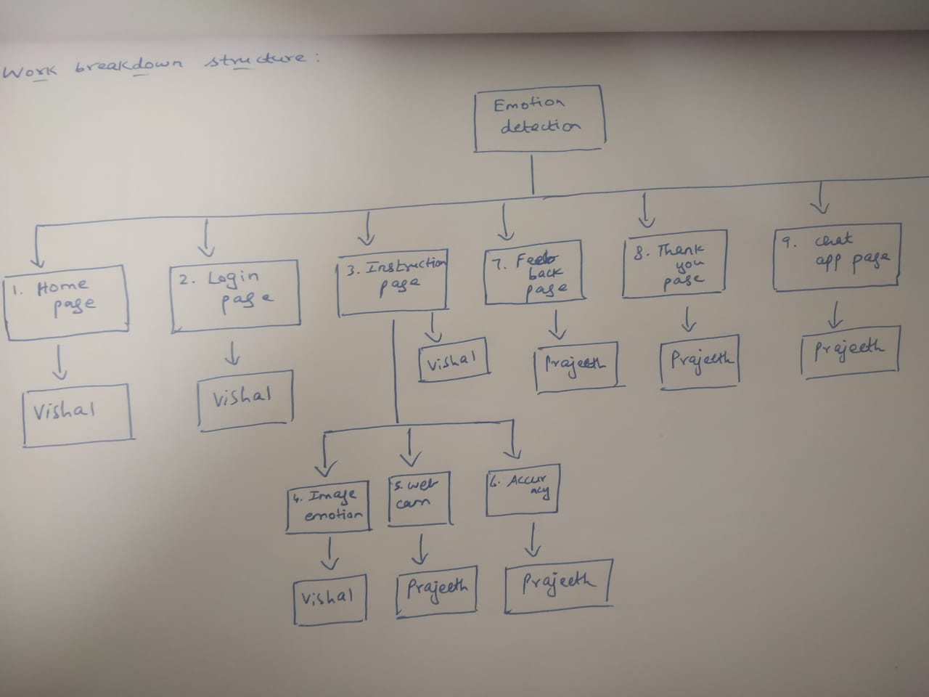

Slide 12
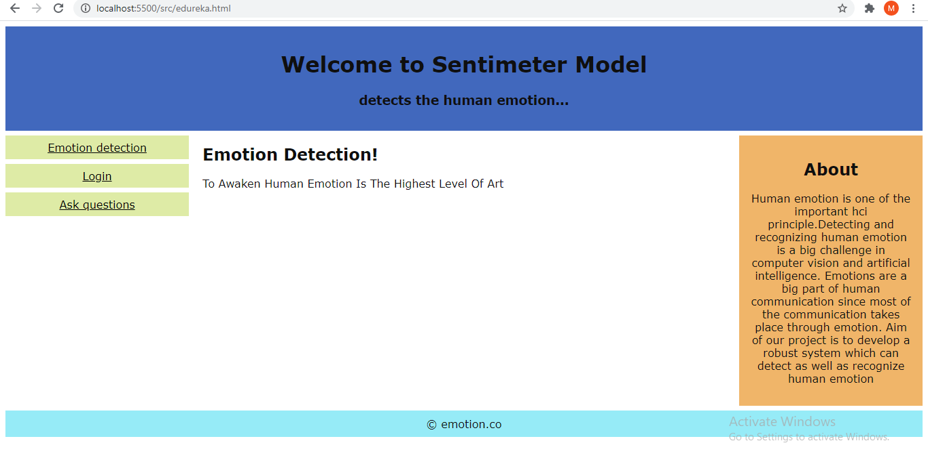
Gui state models : 1. Home page
It is home page with the title, about the website,and login link.

Slide 13
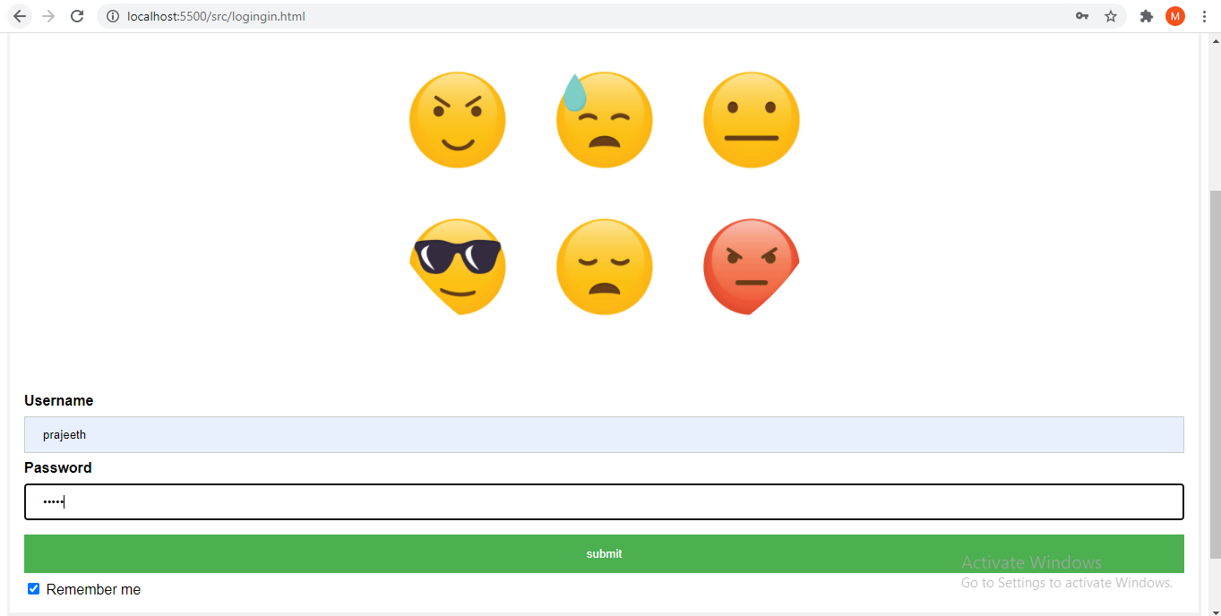
2. Login page
This module is used for login purpose. It asks the user to enter username and password to login to the sentimeter model website.

Slide 14
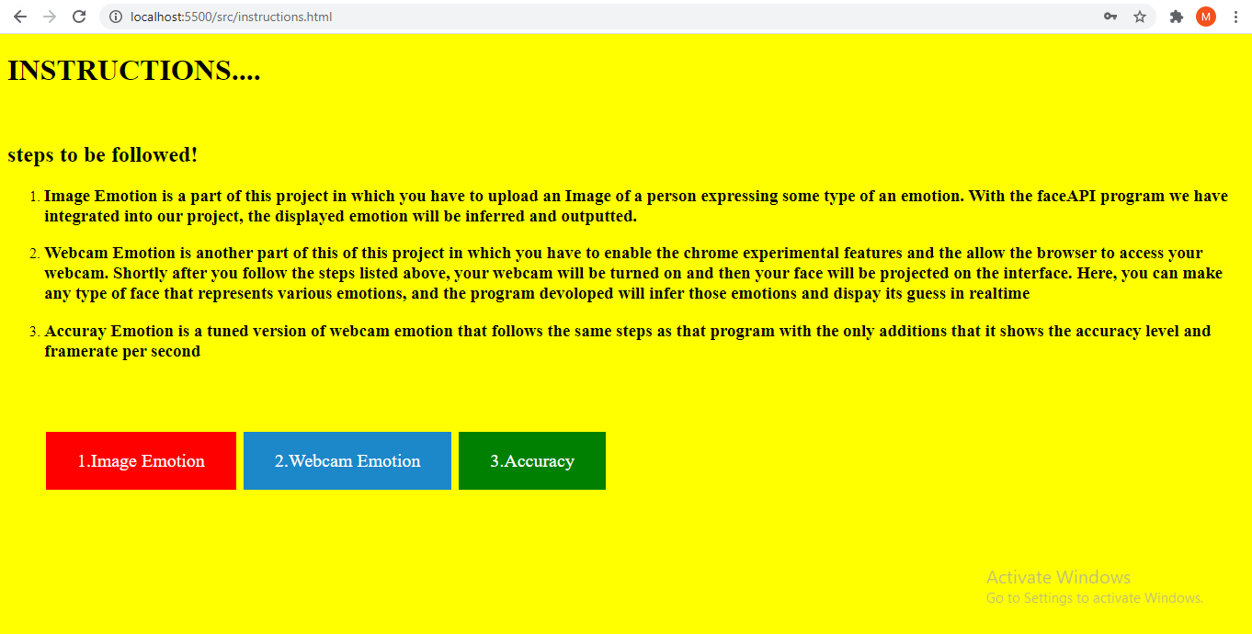
3. Instruction page
This module is to instruct the users how to proceed further.

Slide 15
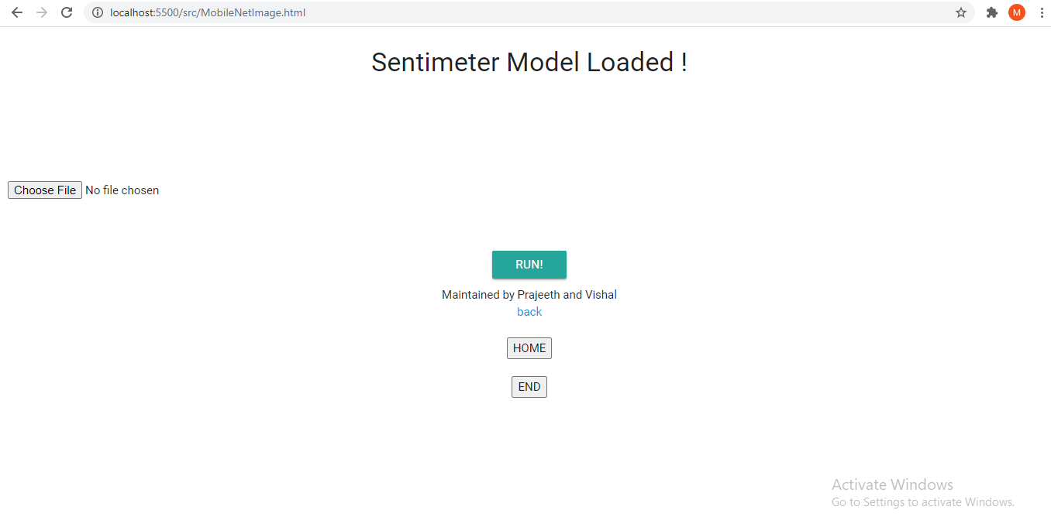
4. Image emotion
Image Emotion is a part of this project in which you have to upload an Image of a person expressing some type of an emotion. With the faceAPI program we have integrated into our project, the displayed emotion will be inferred and outputted.

Slide 16
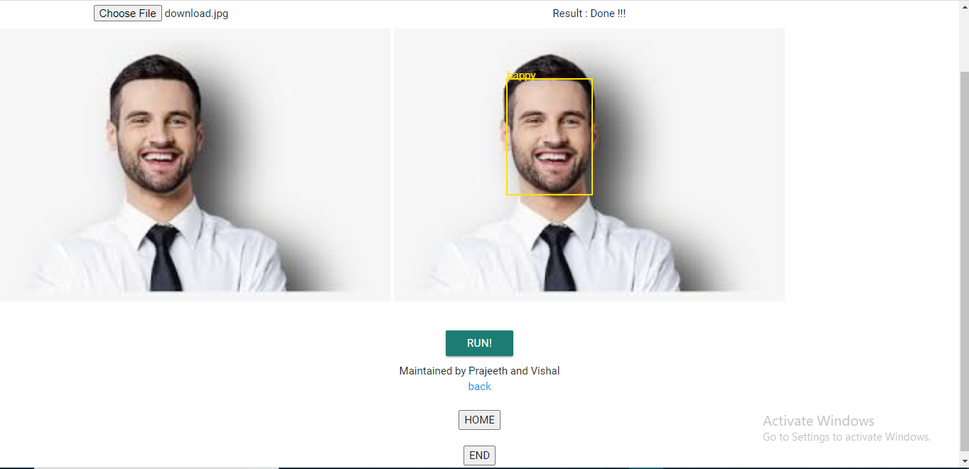

Slide 17
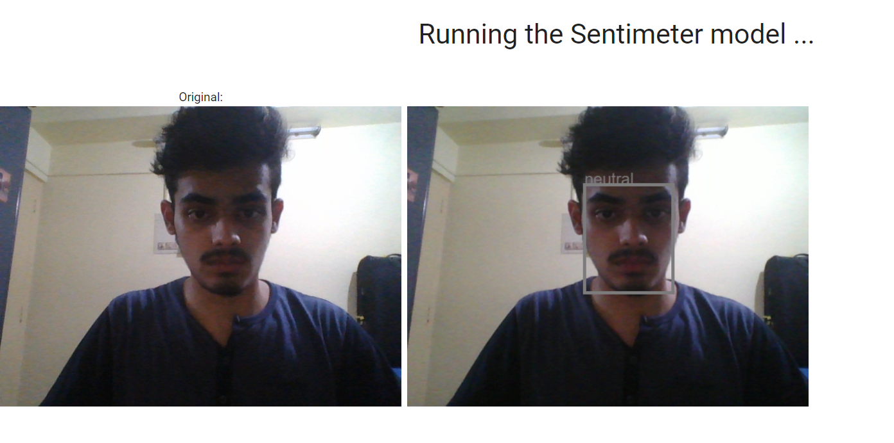
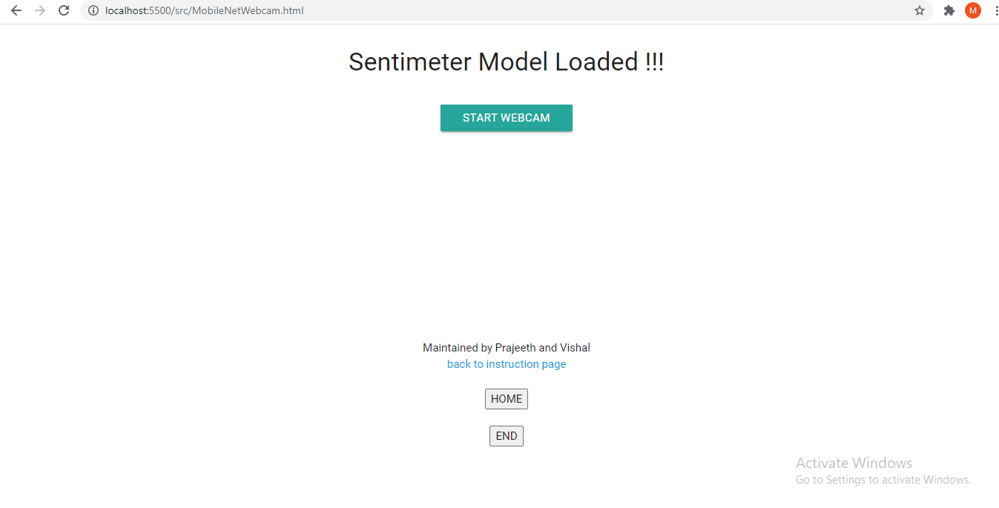
5. Webcam emotion
Webcam Emotion is another part of this of this project in which you have to enable the chrome experimental features and the allow the browser to access your webcam. Shortly after you follow the steps listed above, your webcam will be turned on and then your face will be projected on the interface. Here, you can make any type of face that represents various emotions, and the program devoloped will infer those emotions and dispay its guess in realtime.

Slide 18
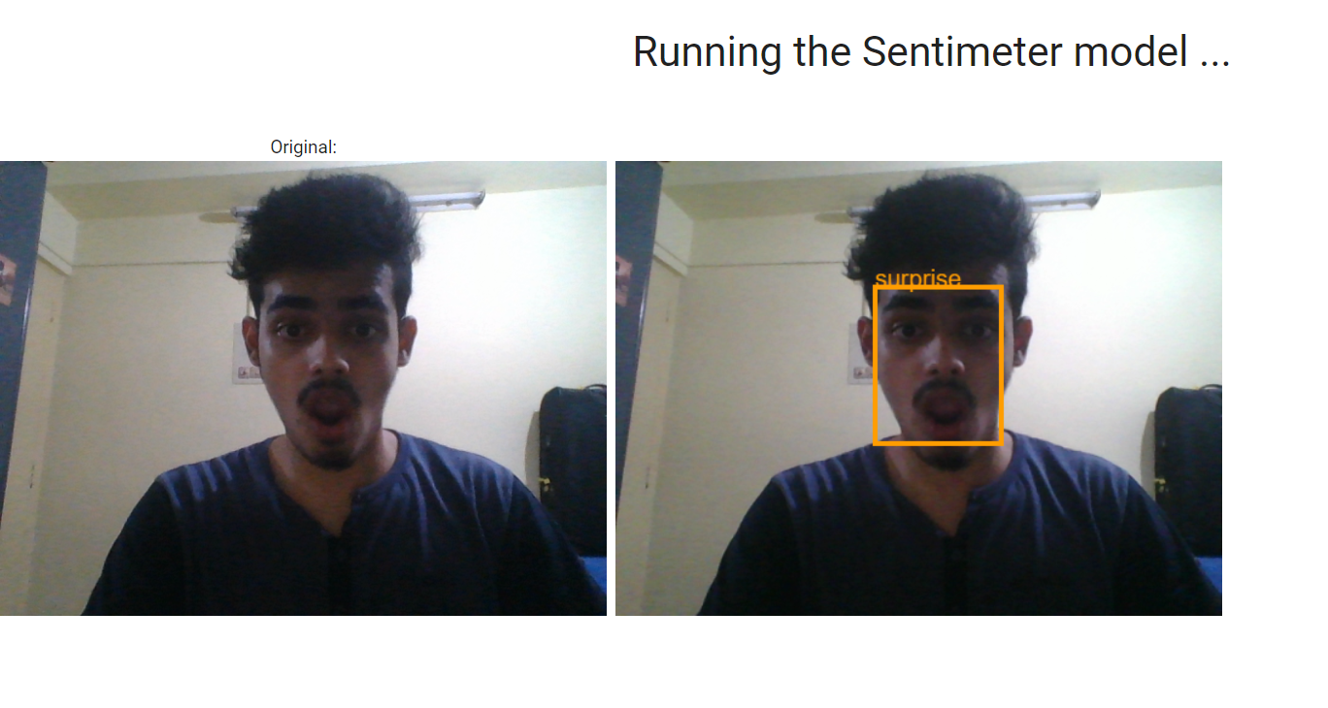

Slide 19
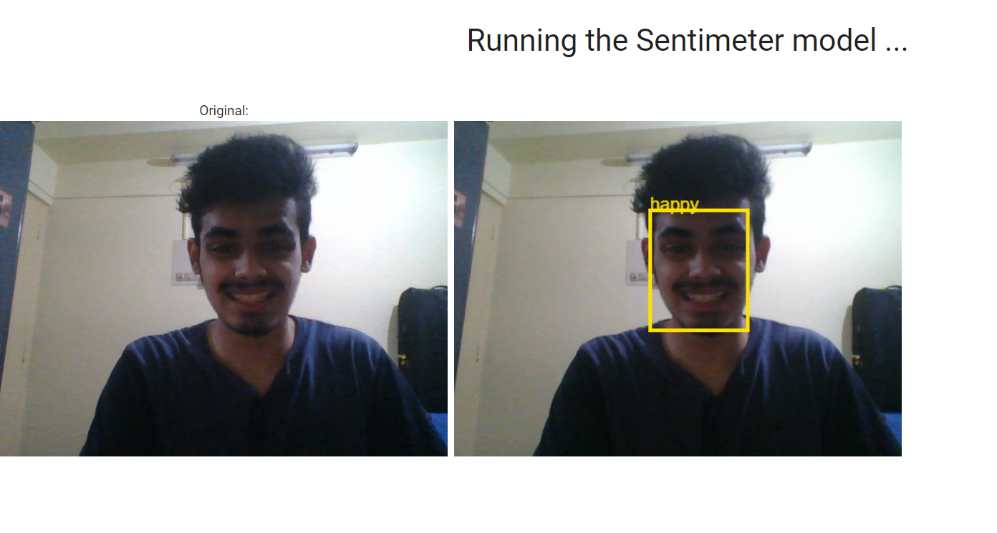

Slide 20
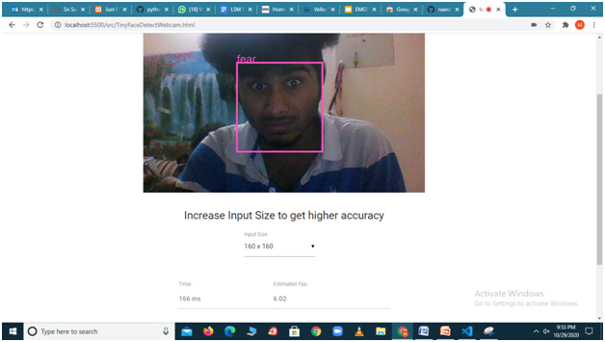
6. Accuracy emotion
Accuray Emotion is a tuned version of webcam emotion that follows the same steps as that program with the only additions that it shows the accuracy level and framerate per second

Slide 21
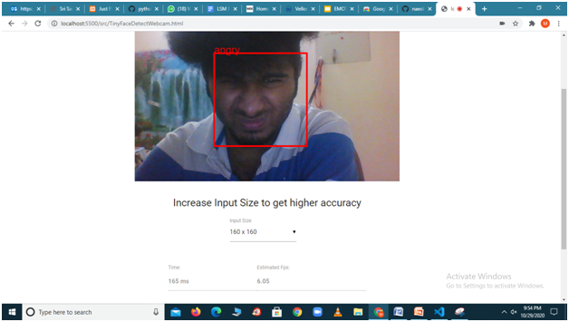
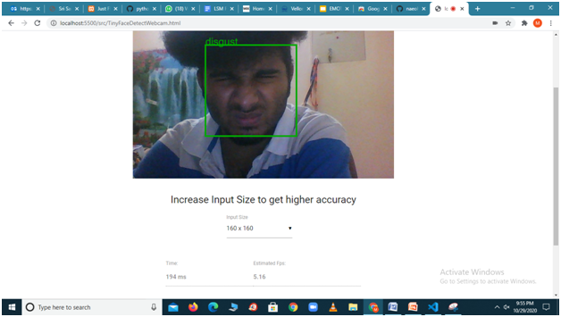
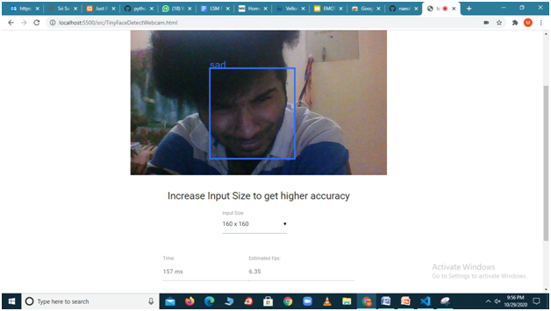

Slide 22
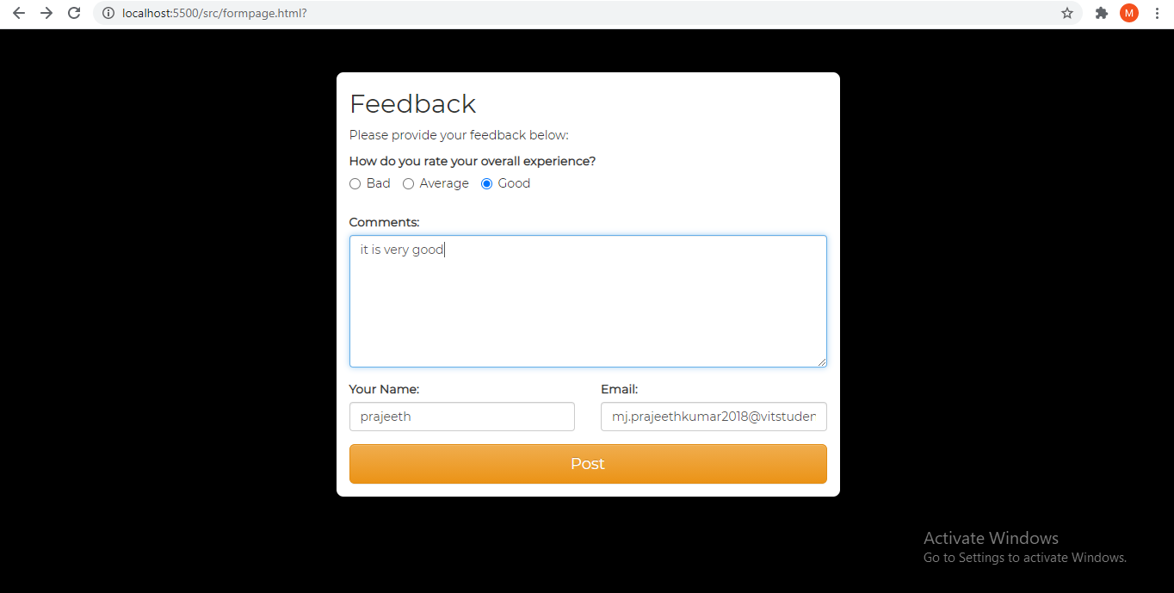
7. Feedback page
This module is to get feedback from the user about the website. It asks the rating and comments to enter if we click on the END button.

Slide 23
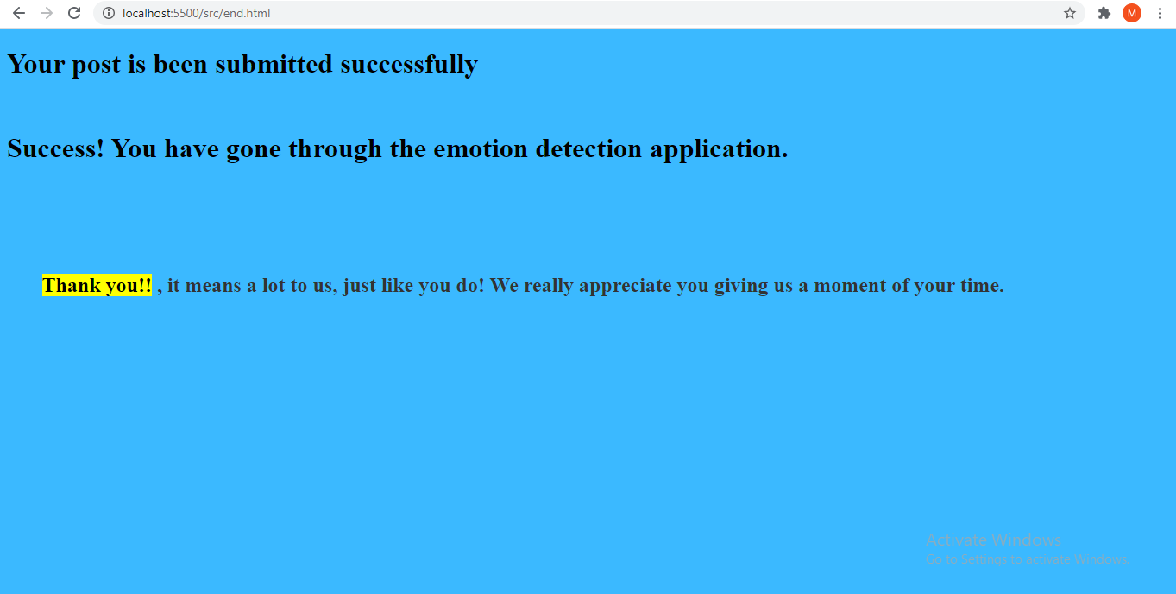
8. End page
This module is the end page like a thank you page after submitting the POST button.

Slide 24
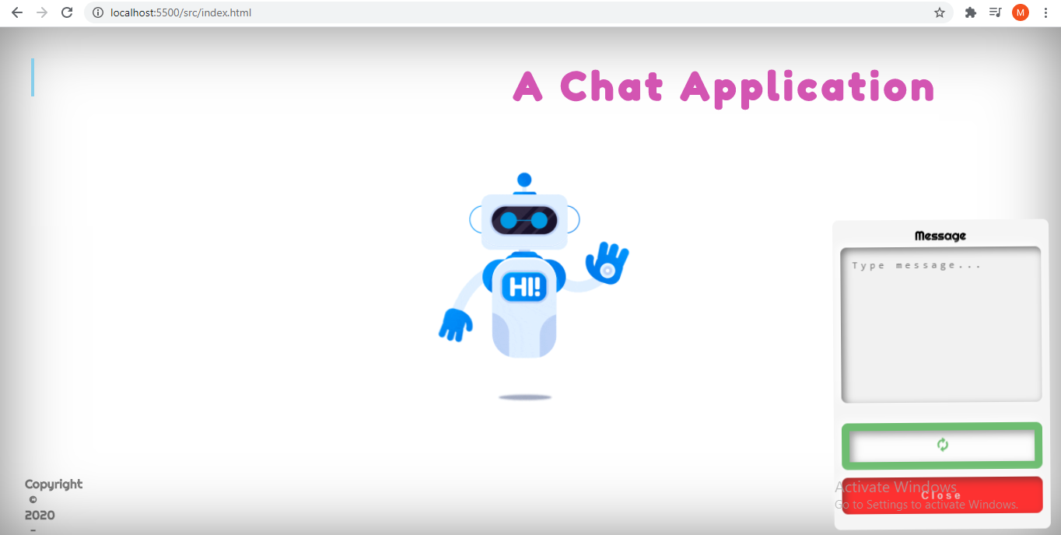
9. Chat application page
This module is used for the users to chat with the admin and ask their queries.

Slide 25
Prototype testing
Username and password should be made mandatory.
Error message should come if the face is not shown in webcam.

Slide 26
Test report(validate the proposed work)
The validation test is a complete test before giving it to the client.
2. Login page
2.1. Giving username and password
2.1.1. Test case 1
Purpose: to verify that username and password is entered or not

Slide 27
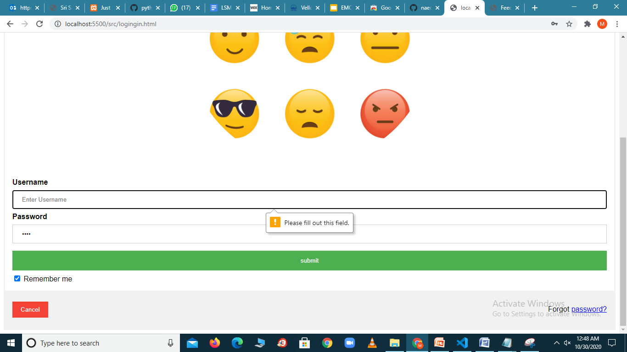
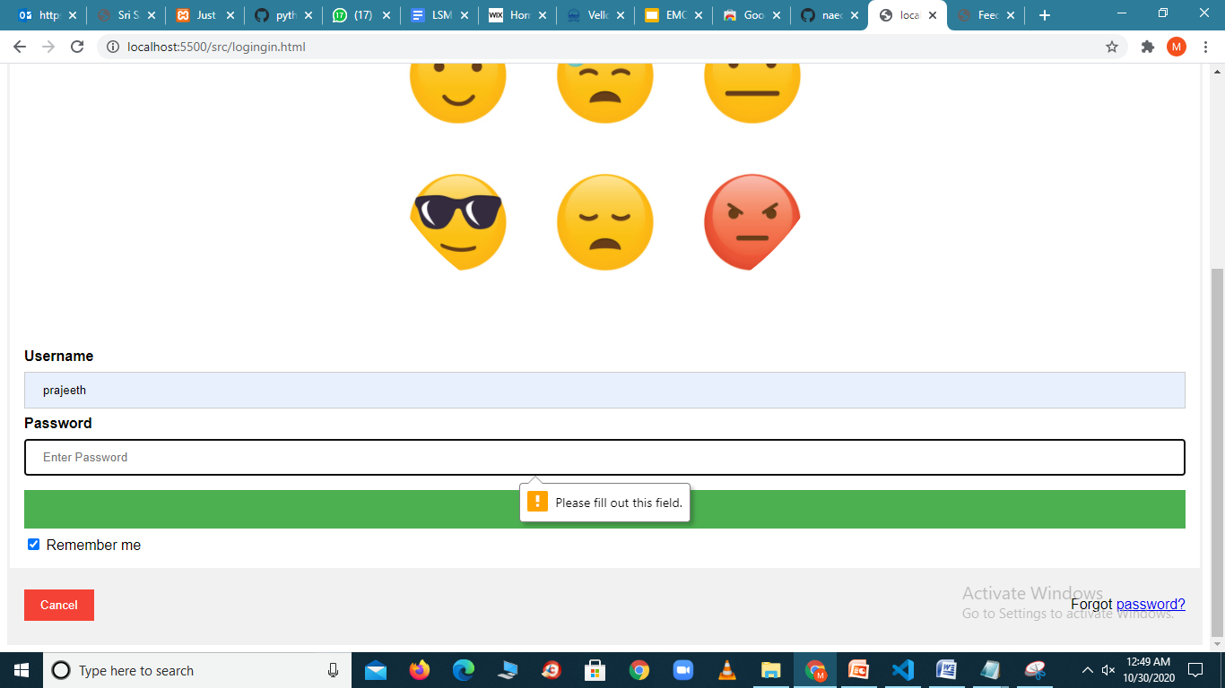
Validating the login page

Slide 28
Validating webcam
3. Webcam page
3.1. Face detected or not
3.1.1. Test case 2
Purpose: to verify that whether the face is detected or not in webcam
It detects only the faces and not any other things

Slide 29
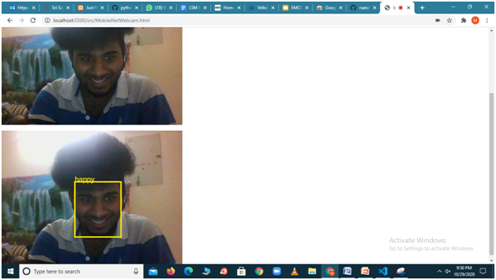
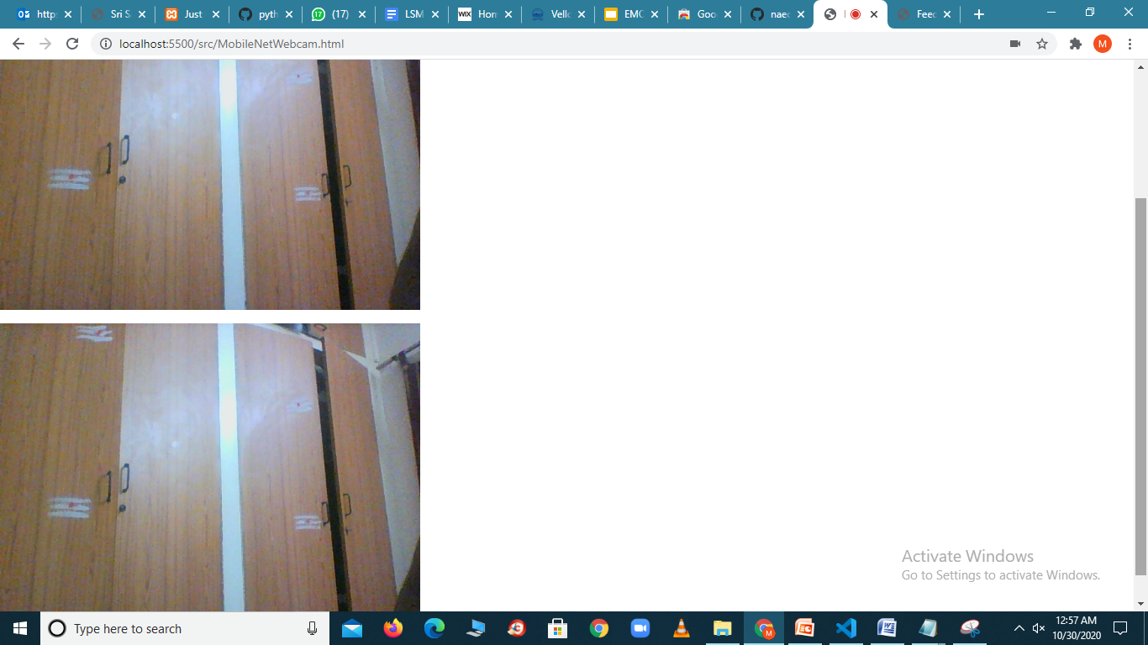

Slide 30
Validating image emotion
Only the image with face reactions only the emotion is detected. The emotion isnt detected for any other images.
It shows no face in the result if face is not in the image.
4.Webcam page
4.1. Face detected or not in image
4.1.1. Test case 3
Purpose: to verify that whether the face is detected or not in image emotion
It detects only the faces and not any other images.

Slide 31
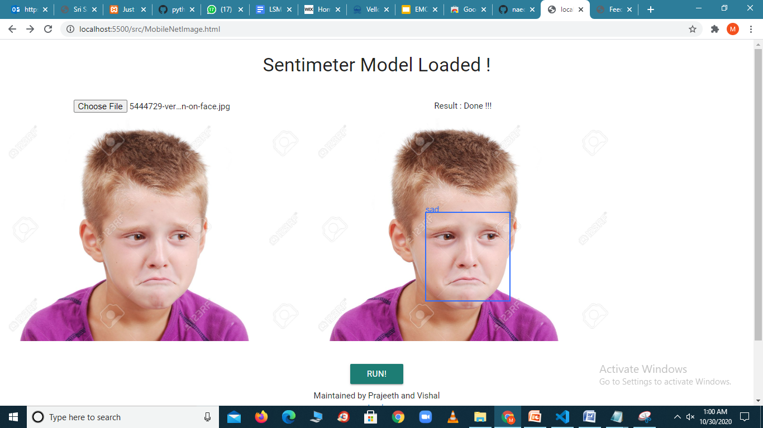

Slide 32
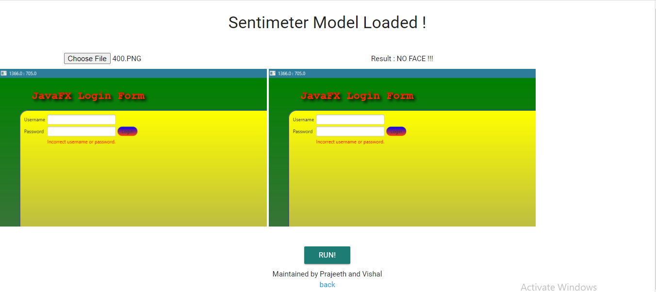

Slide 33
Highlights of the work
Advantages:
-> shows the emotion detection of our face with accuracy , fps(frames per second)
-> followed the graphical user interface and hci principles.

Slide 34
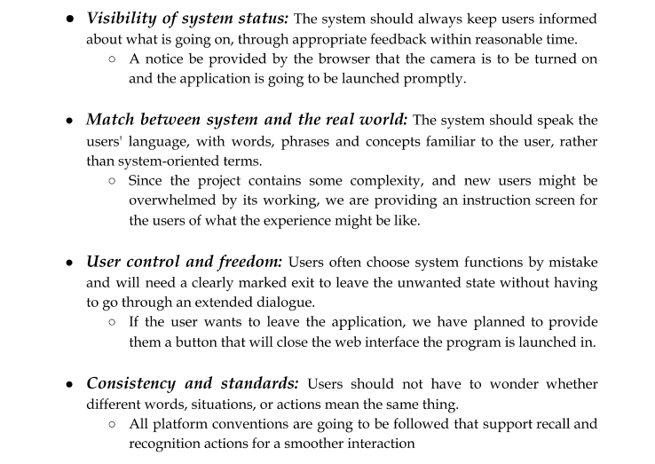

Slide 35
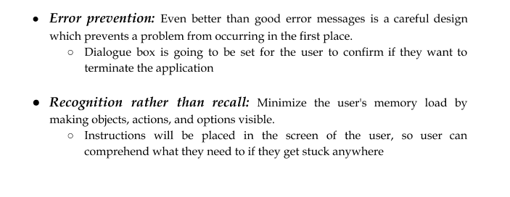

Slide 36
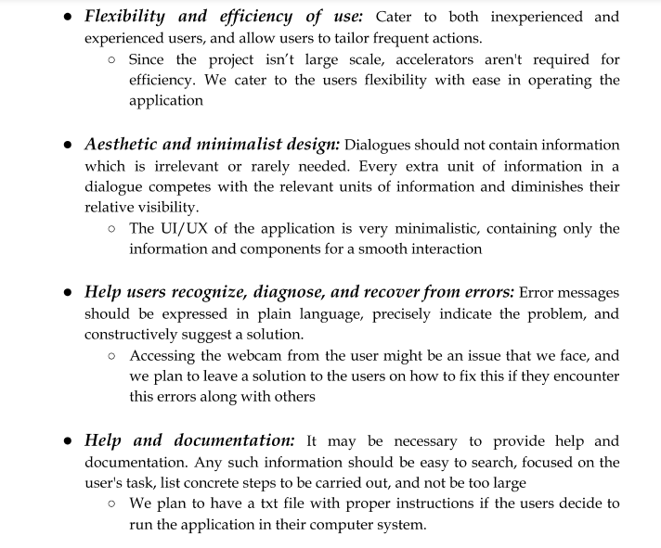

Slide 37

Conclusion
We were able to create Sentimeter, an user friendly interface where people with minimal to no understanding can view and review our application. This has primarily been made to target a mentally challenged audience and assist them in their interaction skills that they are bound to face. In this project report, we went over the 3 modules we developed, image emotion, webcam emotion, and webcam emotion to find accuracy.

Slide 38

Future Works
We would like to clean up the interface more and make it look more radiant and professional.
We would like to add emojis for the respective emotions detected.
We would also like to create a mobile application of our project since its more widespread and our application can be used by many more.

Slide 39
References
Vamshi Krishna Gudipati, Oindrila Ray Barman, Mofica Gaffoor, Harshagandha, Abdelshakour Abuzneid, Efficient Facial Expression Recognition Using Adaboost and Haar Cascade Classifiers, 2016 IEEE.
Namrata Mahajan, Harshad Mahajan, Emotion Detection Algorithm, International Journal of Electrical and Electronics Research, Vol. 2, Issue 2, pp: (56–60), Month: April - June 2014
Emotion Recognition from Facial Expressions using Multilevel HMM Ira Cohen, Ashutosh Garg, Thomas S. Huang,Beckman Institute for Advanced Science and Technology.
Emotion recognition using facial expressions with active appearance models Matthew S. Ratliff,Eric Paterson
https://towardsdatascience.com/face-recognition-using-javascript-api-face-api-js-75af10bc3dee
https://www.infoq.com/news/2020/03/face-api-js/
https://www.youtube.com/watch?v=NT4N_N2FAT4&feature=youtu.be

